Slide 1
Chapter 3
Describing Syntax and Semantics

Slide 2
Chapter 3 Topics
Introduction
The General Problem of Describing Syntax
Formal Methods of Describing Syntax

Slide 3
Why the syntax needs to be described
To learn a new programming language, you have to learn how the syntax is represented
To more we understand the better we use
One of the problems in describing a language is the diversity of the people who must understand the description

Slide 4
Why the syntax needs to be described
An understandable description of a programming language is difficult but essential to the language’s success.
ALGOL 60 and ALGOL 68 were first presented using concise formal descriptions; however, the descriptions were not easily understandable. The levels of acceptance of both languages suffered as a result.

Slide 5
Introduction
Syntax: the form or structure of the expressions, statements, and program units
Semantics: the meaning of the expressions, statements, and program units
Syntax and semantics provide a language’s definition
Users of a language definition
Other language designers
Implementers
Programmers (the users of the language)

Slide 6
Introduction
For example, the syntax of a Java while statement is
while (boolean_expr) statement
The semantics of this is that when the current value of the Boolean expression is true, the embedded statement is executed. Otherwise, control continues after the while construct. Then control implicitly returns to the Boolean expression to repeat the process.

Slide 7
Introduction
Syntax and semantics are closely related.
In a well-designed programming language, the appearance of a statement (syntax) should strongly suggest what the statement is meant to accomplish (semantics).
A concise and universally accepted notation is available for syntax description, but none has yet been developed for semantics.

Slide 8
The General Problem of Describing Syntax: Terminology
A sentence (statement) is a string of characters over some alphabet
A language is a set of sentences
A lexeme is the lowest level syntactic unit of a language (e.g., *, sum, begin)
A token is a category of lexemes (e.g., identifier)

Slide 9
The General Problem of Describing Syntax: Terminology
A Java statement: index = 2 * count + 17;
Lexemes Tokens
index identifier
= equal_sign
2 int_literal
* mult_op
count identifier
+ plus_op
17 int_literal
; semicolon

Slide 10
Formal Definition of Languages
Recognizers
A recognition device reads input strings over the alphabet of the language and decides whether the input strings belong to the language
Example: syntax analysis part of a compiler
Generators
A device that generates sentences of a language
One can determine if the syntax of a particular sentence is syntactically correct by comparing it to the structure of the generator

Slide 11
Formal Methods of Describing Syntax
Describing the sytax of proramming languages
No disagrement on what the syntax of the language
It makes much easier to develop compilers
Backus-Naur Form (1959)
Invented by John Backus to describe the syntax of Algol 58
BNF is a natural notation for describing syntax

Slide 12
BNF Fundamentals
BNF is simple, and sufficiently powerful to describe nearly all of the syntax of programming languages.
It can describe lists of similar constructs, the order in which different constructs must appear, and
Nested structures to any depth, and even imply operator precedence and
Operator associativity.

Slide 13
BNF Fundamentals
A metalanguage is a language that is used to describe another language. BNF is a metalanguage for programming languages.
BNF uses abstractions for syntactic structures. A simple Java assignment statement, for example, might be represented by
<assign> → <var> = <expression>
One example sentence
total = subtotal1 + subtotal2

Slide 14
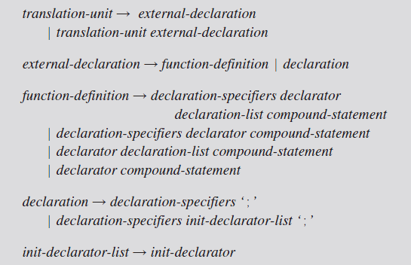
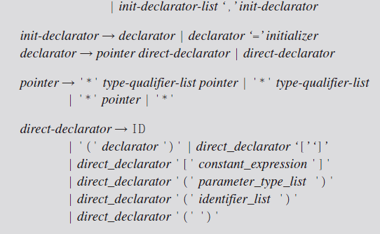
BNF
Partial BNFs for C

Slide 15
BNF Fundamentals
<assign> → <var> = <expression>
Nonterminal terminals (lexemes or tokens)
A rule has a left-hand side (LHS), which is a nonterminal,
a right-hand side (RHS), which is a string of terminals and/or nonterminals
Rule

Slide 16
BNF Fundamentals (continued)
Nonterminals are often enclosed in angle brackets
Examples of BNF rules:
<ident_list> → identifier | identifier, <ident_list>
<if_stmt> → if <logic_expr> then <stmt>
Grammar: a finite non-empty set of rules
A start symbol is a special element of the nonterminals of a grammar
identifiers the names of variables, methods, classes, etc.

Slide 17
BNF Fundamentals (continued)
Nonterminal symbols can have two or more distinct definitions, representing two or more possible syntactic forms in the language.
Multiple definitions can be written as a single rule, with the different definitions separated by the symbol |, meaning logical OR.

Slide 18
BNF Fundamentals (continued)
Example, a Java if statement can be described with the rules
<if_stmt> → if ( <logic_expr> ) <stmt>
<if_stmt> → if ( <logic_expr> ) <stmt> else <stmt>
or with the rule
<if_stmt> → if ( <logic_expr> ) <stmt>
| if ( <logic_expr> ) <stmt> else <stmt>
<stmt> represents either a single or a compound statement

Slide 19
BNF Rules
An abstraction (or nonterminal symbol) can have more than one RHS
<stmt> → <single_stmt>
| begin <stmt_list> end

Slide 20
Describing Lists
Syntactic lists are described using recursion
<ident_list> → ident
| ident, <ident_list>
A derivation is a repeated application of rules, starting with the start symbol and ending with a sentence (all terminal symbols)

Slide 21
An Example Grammar - 1
<program> → <stmts>
<stmts> → <stmt> | <stmt> ; <stmts>
<stmt> → <var> = <expr>
<var> → a | b | c | d
<expr> → <term> + <term> | <term> - <term>
<term> → <var> | const

Slide 22
An Example Derivation - 1
<program> => <stmts> => <stmt>
=> <var> = <expr>
=> a = <expr>
=> a = <term> + <term>
=> a = <var> + <term>
=> a = b + <term>
=> a = b + const

Slide 23
Grammer
A grammar is a generative device for defining languages.
The sentences of the language are generated through a sequence of applications of the rules,
beginning with a special nonterminal of the grammar called the start symbol often named <program> .

Slide 24
Derivations
This sequence of rule applications in grammer, is called a derivation
Every string of symbols in a derivation is a sentential form
A sentence is a sentential form that has only terminal symbols
A leftmost derivation is one in which the leftmost nonterminal in each sentential form is the one that is expanded
A derivation may be neither leftmost nor rightmost

Slide 25
A Grammar for a Small Language
<program> → begin <stmt_list> end
<stmt_list> → <stmt>
| <stmt> ; <stmt_list>
<stmt> → <var> = <expression>
<var> → A | B | C
<expression> → <var> + <var>
| <var> – <var>
| <var>

Slide 26
An Example Derivation - 2
<program> => begin <stmt_list> end
=> begin <stmt> ; <stmt_list> end
=> begin <var> = <expression> ; <stmt_list> end
=> begin A = <expression> ; <stmt_list> end
=> begin A = <var> + <var> ; <stmt_list> end
=> begin A = B + <var> ; <stmt_list> end
=> begin A = B + C ; <stmt_list> end
=> begin A = B + C ; <stmt> end
=> begin A = B + C ; <var> = <expression> end
=> begin A = B + C ; B = <expression> end
=> begin A = B + C ; B = <var> end
=> begin A = B + C ; B = C end

Slide 27
An Example Grammar - 3
<assign> → <id> = <expr>
<id> → A | B | C
<expr> → <id> + <expr>
| <id> * <expr>
| ( <expr> )
| <id>

Slide 28
An Example Derivation - 3
<assign> => <id> = <expr>
=> A = <expr>
=> A = <id> * <expr>
=> A = B * <expr>
=> A = B * ( <expr> )
=> A = B * ( <id> + <expr> )
=> A = B * ( A + <expr> )
=> A = B * ( A + <id> )
=> A = B * ( A + C )

Slide 29
An Example Derivation - 3
A = B * ( A + C )
A = C + B
C = B * A
C = C * (B + A)
B = A + C * B

Slide 30
Parse Tree
Syntax establishes structure, not meaning, but the meaning of a sentence (or a program) is related to its syntax.
We must construct the syntax so that it reflects the semantics we will eventually attach to it as much as possible.

Slide 31
Parse Tree
To make use of the structure of a program to determine its semantics, we must have a way of expressing this structure as determined by a derivation

Slide 32
Parse Tree
A standart method for doing this is with a parse tree, which is a graphical depiction of the replacement process in a derivation
Grammer => Derivation => Parse Tree

Slide 33
Parse Tree
One of the most attractive features of grammars is that they naturally describe the hierarchical syntactic structure of the sentences of the languages they define.
These hierarchical structures are called parse trees.

Slide 34
Parse Tree
A hierarchical representation of a derivation
<program>
<stmts>
<stmt>
<var>
=
<expr>
a
<term>
+
<term>
<var>
const
b

Slide 35
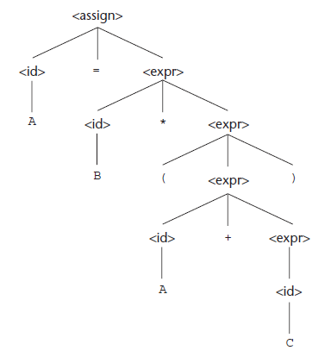
Parse Tree
A parse tree for the simple statement
A = B * (A + C)

Slide 36
Parse Tree exercises
Q6, a,b,c

Slide 37
Extended BNF
Optional parts are placed in brackets [ ]
<proc_call> -> ident [(<expr_list>)]
Alternative parts of RHSs are placed inside parentheses and separated via vertical bars
<term> → <term> (+|-) const
Repetitions (0 or more) are placed inside braces { }
<ident> → letter {letter|digit}

Slide 38
BNF and EBNF
BNF
<expr> → <expr> + <term>
| <expr> - <term>
| <term>
<term> → <term> * <factor>
| <term> / <factor>
| <factor>
EBNF
<expr> → <term> {(+ | -) <term>}
<term> → <factor> {(* | /) <factor>}

Slide 39
Recent Variations in EBNF
Alternative RHSs are put on separate lines
Use of a colon instead of =>
Use of _{opt} for optional parts
Use of oneof for choices

